Slide 1
Problem Statement
Thera Bank has a strong base of depositors (liability customers) but relatively fewer borrowers (asset customers). In particular, the management wants to explore ways of converting its liability customers to personal loan customers (while retaining them as depositors), to bring in more loan revenue.
📊 Dataset Size: 5,000 customers
Customer Attributes
Demographics & Financials
Age – Age of depositor
Experience – Years of work
Income – Annual income ($000)
Family – Family size
Education – 1: Undergrad | 2: Graduate | 3: Advanced
Mortgage – Home loan amount ($000)
Banking Behavior
CCAvg – Avg. monthly credit card spend ($000)
CreditCard – Uses bank-issued credit card
Online – Uses internet banking
Securities Account – Investment / brokerage account
CD Account – Fixed deposit account
Feature Engineering
AgeGroup - ['20-30', '30-40', '40-50','50-60' ,'60+']
CCToIncomeRatio - How much of the month income goes into credit card expenses
MortgageCategory – Low (1-80), Normal (81-300), High (300-700)
Target Variable
Personal Loan – Accepted last campaign loan (Yes / No)
Tech Stack
EDA - Seaborn, Matplotlib
Modeling - Scikit-learn, Imbalanced-learn (imblearn)
Data Processing - Pandas, NumPy
Saving the model - Pickle

Slide 2
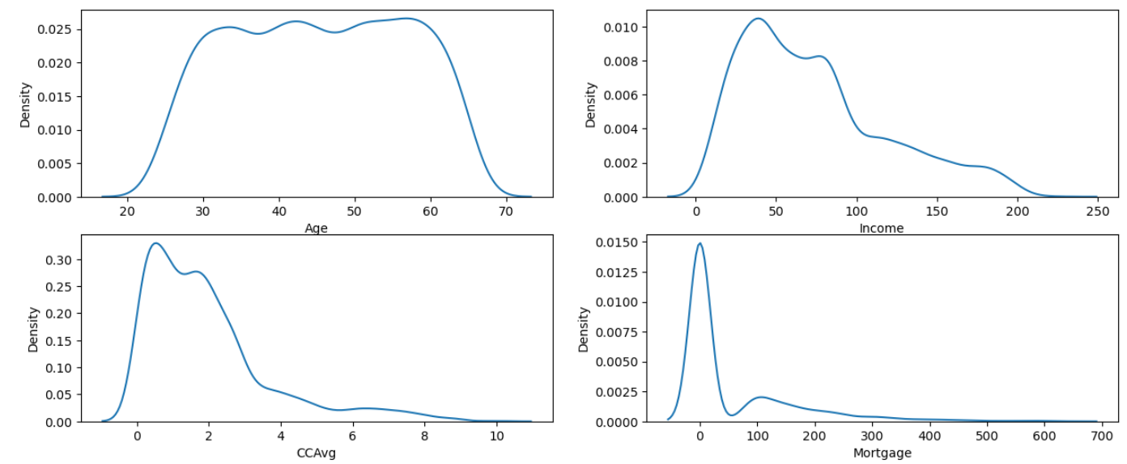
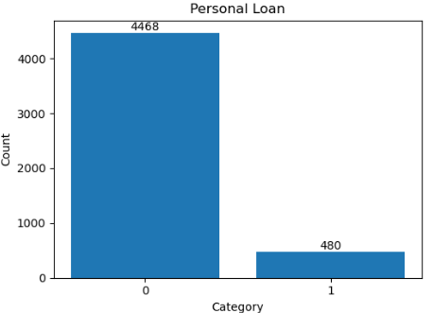
Exploratory Data Analysis
Insights:-
The depositors are mostly of the working class age (Ranging from 30 to 60). There are very few people below 25 and above 60 (as seen by the steepness of the plot)
Income of most of the people lie in between 30k - 120k(There are many people who earn above 100k, but their numbers are comparatively less)
Average CC Spending per month is 0.5k to 3k for most of the people. It also goes as far as 8-9k for few
The mortgage value for most of the people is nearly 0 (highly skewed at 0), and those who have a mortgage have it around 80k - 200k, with very less people beyond that value (above 300k)
Roughly only 10% of people took personal loan in the last campaign

Slide 3
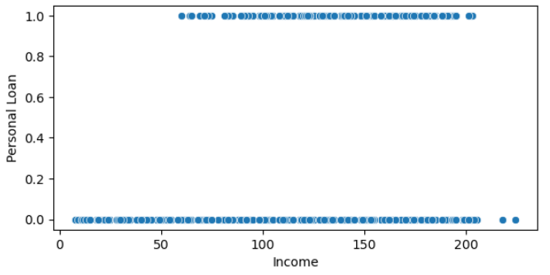
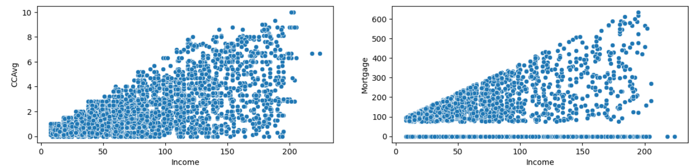
Exploratory Data Analysis
Only people whose income is above 50k took loan in the last campaign
CCAvg and Mortgage are seen to be increasing as Income increases. Spearman correlation value between CCAvg and Income is 0.58. Correlation value between Income and Mortgage (for people with Mortgage > 0) is 0.63

Slide 4
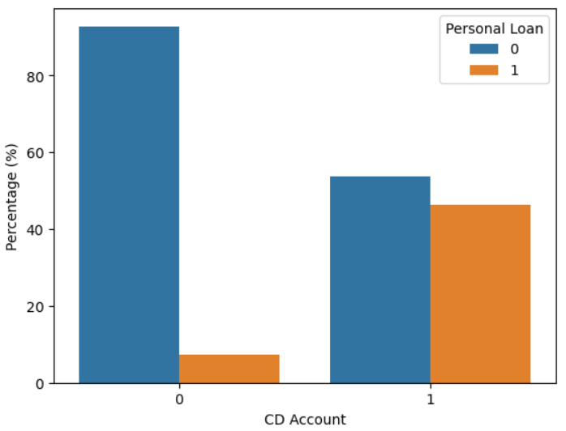
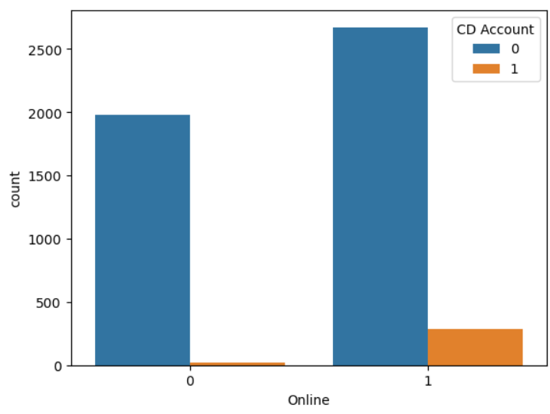
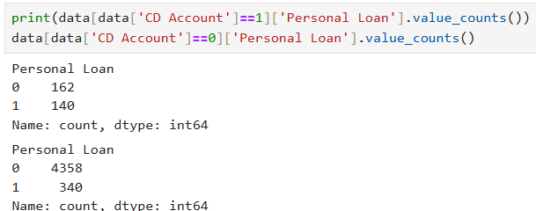
CD Account vs Personal Loan
Almost all people who have CD account in the bank uses its Online services
Hence, we can reach out to them (CD account holders) for campaigning by Online services
46% of people with CD account took personal loan, while only 7% of non-CD Account holders took loan. (Securities account did not make much difference, hence not included)

Slide 5
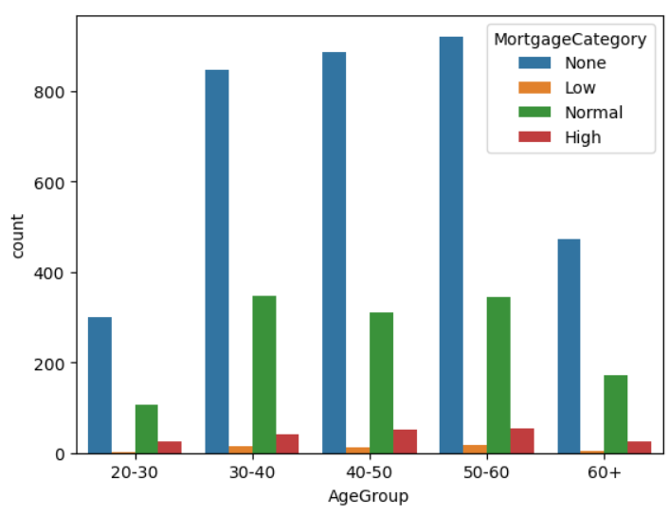
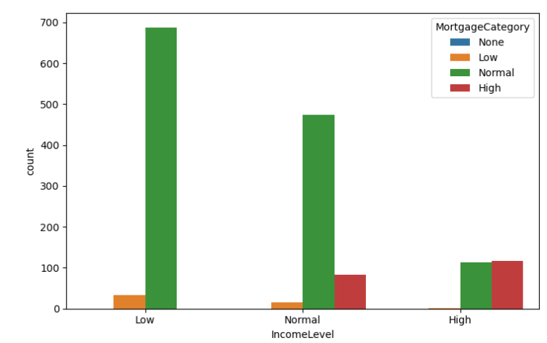
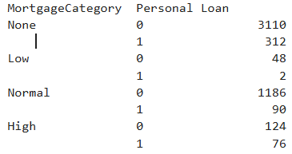
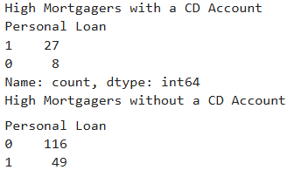
Mortgage vs Personal Loan
For the people who have mortgages,
45% of Low income, 31% of Normal income and only 7% of High income people have Normal Mortgage
Most of the high mortgages were of people with high income
Most mortgages are of people with low incomes
There are mostly people who have a normal category Mortgage (seen in all groups) (of the ones who have mortgages). Highest High mortgagers are aged 40-50 and 50-60, which is due to the fact that they are more in numbers
Moreover, 77% of high mortgagers with CD Account took loan, while approximately 30% of high mortgagers without CD account took loan
38% of High Mortgagers took personal loan, and most high mortgages were taken by people with High income.

Slide 6
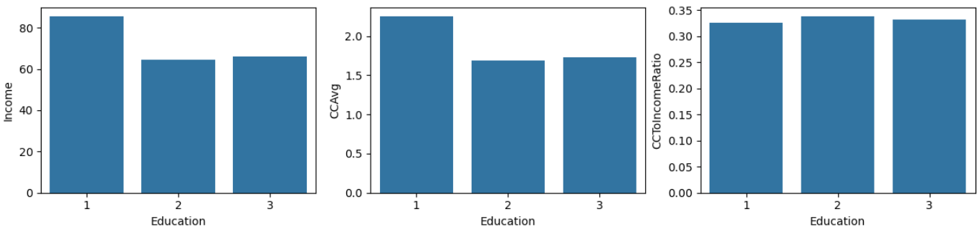
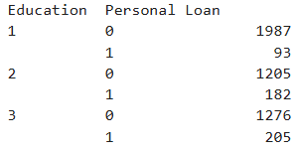
Education vs Personal Loan
Undergrad people earn more on average than Graduates and Advanced people. They also spend higher on CreditCards. However, the CCToIncomeRatio is almost same for each category
Out of all the loan takers, only 20% of them were with Education level 1, while the rest 80% were taken by people with Education level 2 and 3

Slide 7
Business Actions that can be taken
No need to campaign much to people having income less than 50k (no one with income below 50k took personal loan)
Prioritize people with a CD Account (6.5x more likely to take a loan). Moreover, almost all CD holders use online services, hence they can be campaigned on the online services (reducing the campaigning costs)
Focus more on people with high mortgages (who are mostly people with high income. They are also mostly aged 40-60)
Furthermore, out of these high mortgagers, 77% of people who held a CD Account and 30% of people who didn't hold CD Account took personal loan
Customers who are graduates/professionals are more likely to take loan than undergraduates (Out of all loan takers, 80% had education = 2 or 3, even though there are higher number of people with Education level 1)
Groups to focus on:-
People with Income > 50000 USD
People aged 30-60
CD Account holders
High mortgagers (who also happen to be people with high income)
CD Account holders > No CD Account holders within High mortgagers
Graduates and professionals

Slide 8
Model building
Model Development Workflow
Feature Selection Based on exploratory data analysis (EDA), the following features were selected for modeling: Age, Income, CD Account, Mortgage, Education, CCAvg, and CCToIncomeRatio.
Preprocessing For Logistic Regression, a ColumnTransformer was used to apply appropriate scaling and encoding to the input features.
Pipeline Construction
Logistic Regression: The pipeline consisted of class imbalance handling using SMOTENC (SMOTENC chosen over SMOTE because the input features had categorical column), followed by preprocessing, and finally the Logistic Regression model.
Random Forest Classifier: Since Random Forest models do not require feature scaling or encoding, the pipeline included only SMOTENC for imbalance handling and the model itself.
4. Hyperparameter Tuning The complete pipelines were passed to GridSearchCV, allowing hyperparameter optimization to be performed in a cross-validated and leakage-free manner.

Slide 9
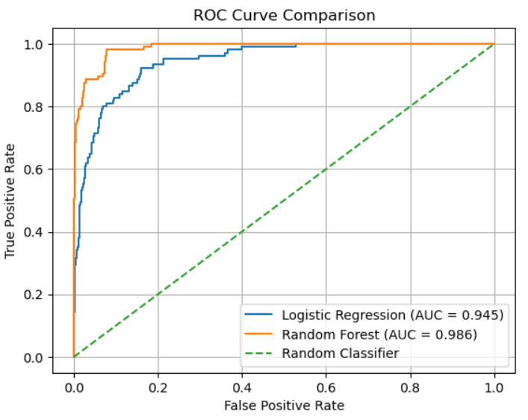


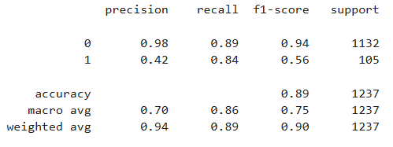
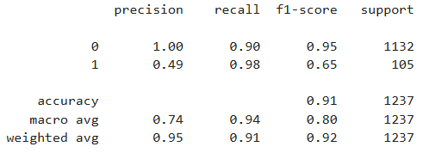
Model Comparing
False Positives :- In actual the person did not take loan but the model predicts he/she took the loan. Waste of resources and time
False Negatives :- Person took the loan but the model predicted it did not. Waste of potential income for the bank.
False Negative error is more dangerous than False positive error, hence we use recall_score in GridSearch's scoring parameter
Logistic Regression:-
RandomForestClassifier:-
Confusion matrix shows that RandomForectClassifier (RFC) has a better recall score, which is what we need in our case
Additionally, the ROC_AUC also shows that RFC performs better overall across all threshold values since it has more area
Therefore, RFC is a better performing model than LogisticRegression.

Slide 10
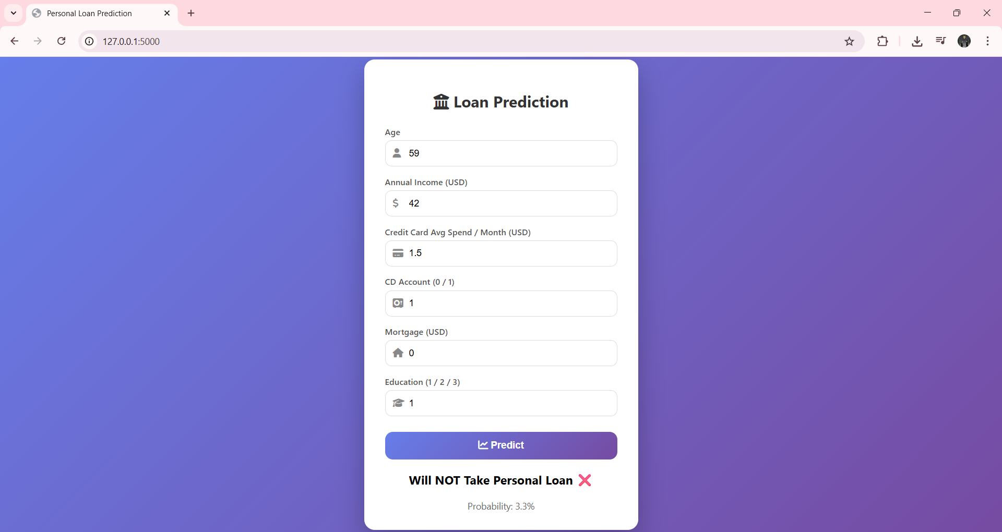

Model Deployment
The model was then saved using the pickle library, and was then deployed on a localhost page (the deployment code was written with the help of Chatgpt)

Slide 11
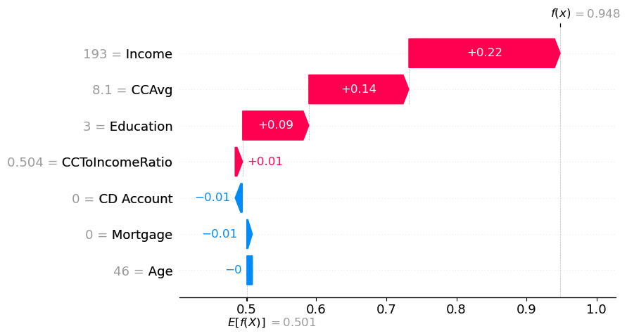
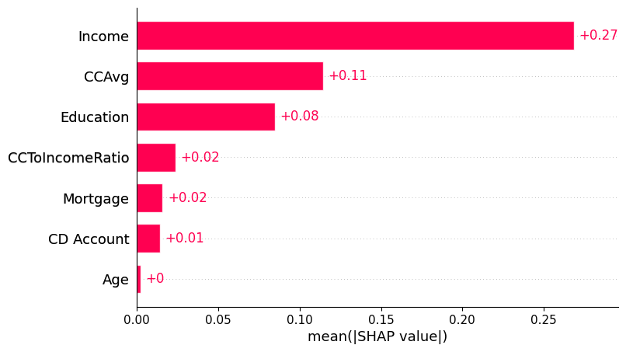
SHAP – Model explainability
The model predicts a 94.8% probability (using these specific features) of the customer taking the loan, starting from a base value of 50.1%.
This high prediction is mainly driven by high income, strong credit card spending, and education level.
Other factors like age, mortgage, and CD account have minimal impact, so they do not significantly affect the outcome.
(This is for a specific example)
SHAP value bar plot of the model.
From this, we can see the model relies heavily on Income, CCAvg, Education, while other columns have minimal impact.
Seeing the graph, we can also see that Age input feature is of no use, and hence can be removed from the model.

Slide 12
New learnings
Thinking and performing analysis with a focus on business benefit
Imbalance handling using techniques like SMOTE and class_weights
Building an end-to-end machine learning pipeline
Using GridSearchCV with cross-validation for hyperparameter tuning
Model comparison using metrics like Confusion matrix, ROC_AUC curve, and Classification report.
Using SHAP for model explainability.

